Slide 1


Covid Stock Retail Data
University of Minnesota Data Visualization and Analytics Boot Camp
Team 7 - Project 1
Cherno Jallow - Lowes
Chris Schultz - Walmart
Wei Kent Chen - Target
Chloe Li - Costco

Slide 2
Project Description
This project attempts to analyze the impact that the COVID-19 pandemic had on the retail stocks for Lowes, Walmart, Target and Costco.
Questions:
How did the stocks perform pre covid? Jan - 2019 to Dec -2019
How did the stocks perform during the pandemic before the vaccine release? Jan-2020 to Nov - 2020
How did the stocks perform during the pandemic after the vaccine release? Dec-2020 to Dec 2021

Slide 3
Solution Approach
Pull retail stock data from yfinance via API
Use of Jupyter Notebook
Hypothesis: We assumed that the stock price will go down during the pandemic before the vaccine release

Slide 4
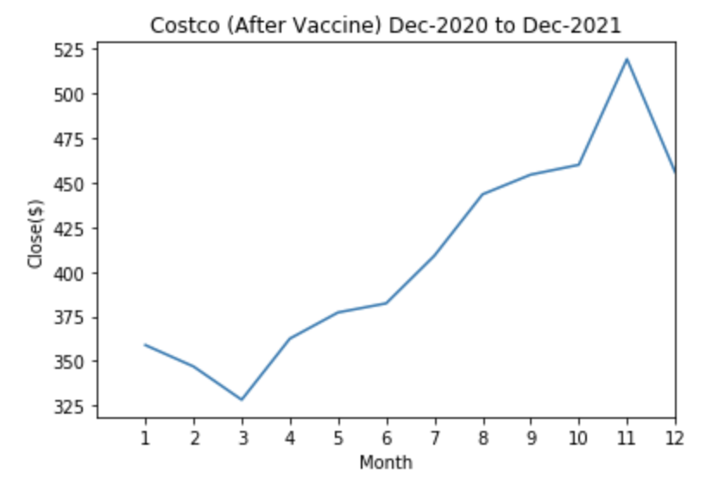
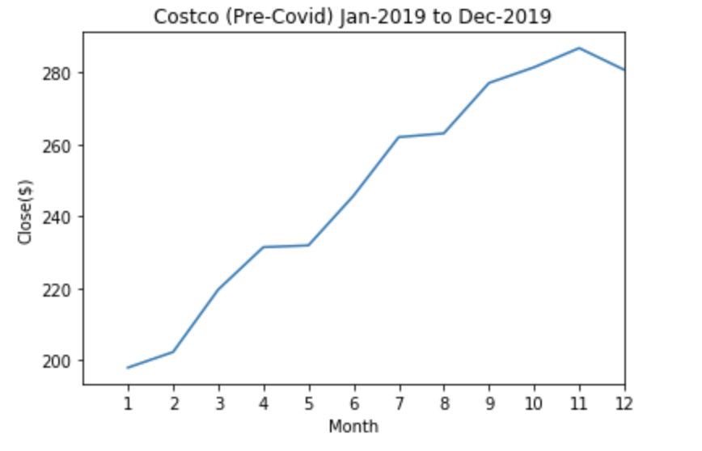
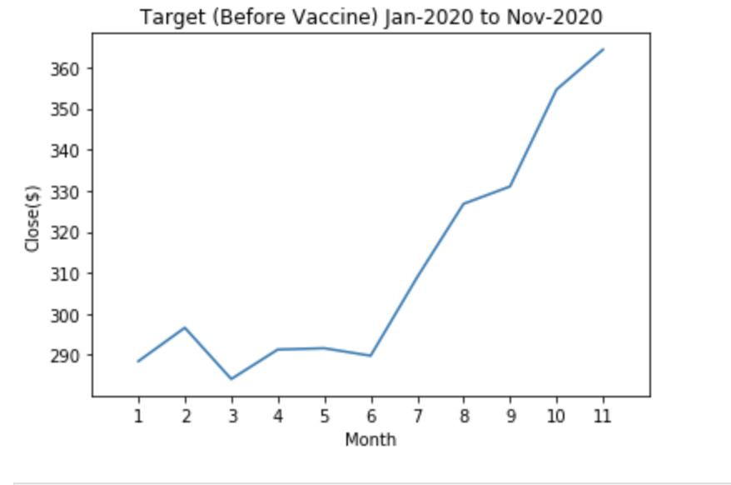
Costco (COST)
Summary of findings
Hypothesis: I assumed that the stock price for Costco will go down during the pandemic before the vaccine release which disproven
consultation: Costco was not impact with the pandemic, even because of the pandemic consumers were spend more time at home and shop online, therefore the retail industries stock trending up further.
Reference
yfinance.com
Notes:
when we look at the pre covid graph, it was going up at the begging, howeven at the end of 2019 and the beginning 6 months of the 2020 stock price just fluctuating between $290 to $300, after vaccine come out the first 3 months stock price go down a little, but after the stock prices goes up

Slide 5
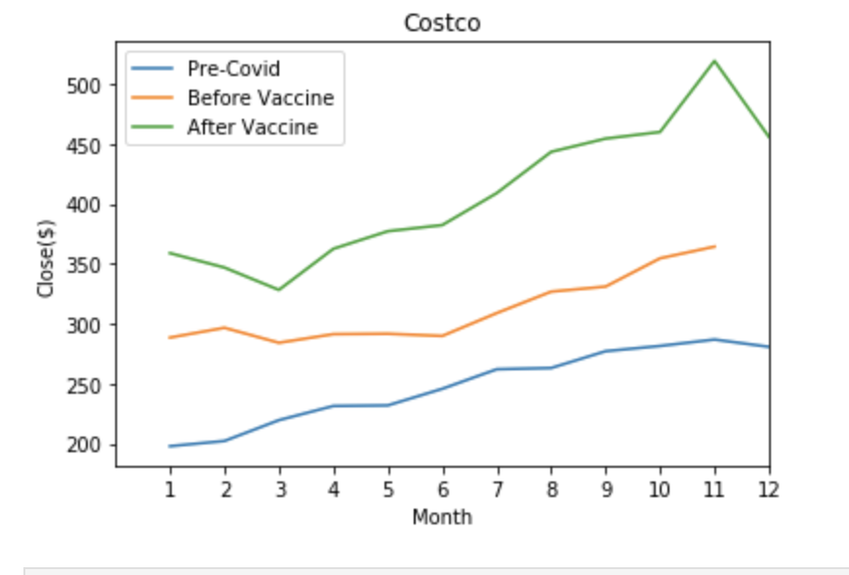
Costco
Combine three data together, we can see after vaccine the stock price was double compare to the pre-covid.

Slide 6
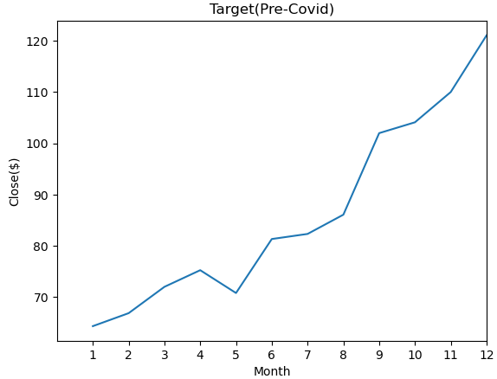
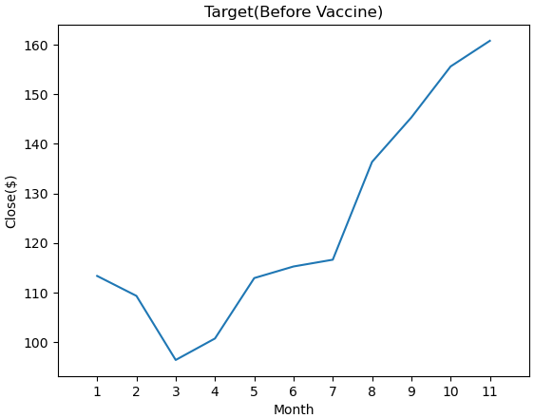
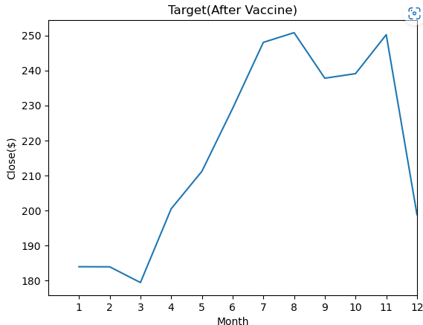
Target (TGT)
Jan 19-Dec 19
Jan 20-Dec 20
Dec 20-Dec 21
Summary of findings
Hypothesis:
We assume that Target’s stock would slowly decline Pre-Covid
We assume that Target’s stock will decline significantly before the vaccine is released
We assume that Target’s stock will slowly increase before the vaccine is released
Results
Target’s stock was not affected during the Pre-Covid period and it is increasing on a monthly basis until December 2019.
During the pandemic, before the release of the vaccine, there was a minor decline in the stock price from Jan 20 to March 20. Target then opted for online business which sees an increase of 145% in online business sales and the overall sales for 2020 soar to 19.3%
After the vaccine was released, there is a huge increase in the stock market as sales were booming, up until October 21, where the stock is increasing as a result of higher expenses due to supply chain disruptions.

Slide 7
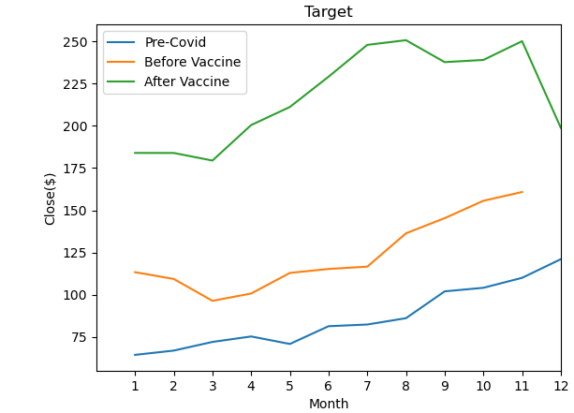
Target

Slide 8
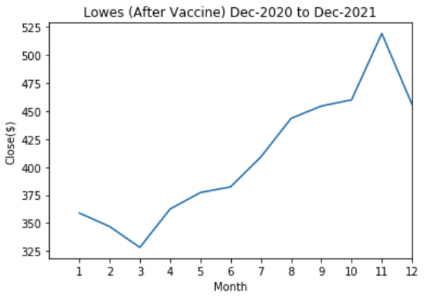
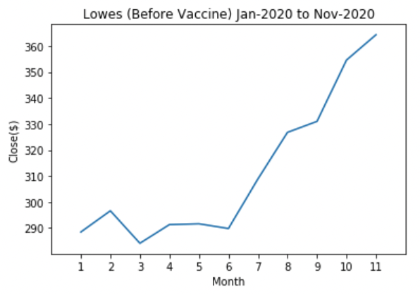
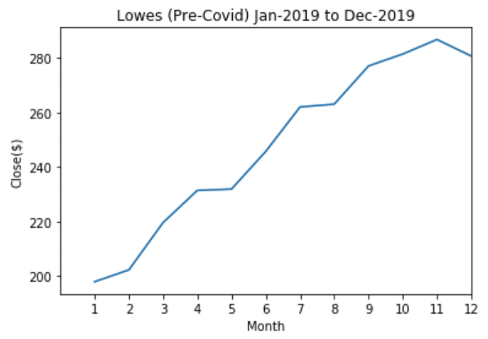
Lowes (LOW)

Slide 9
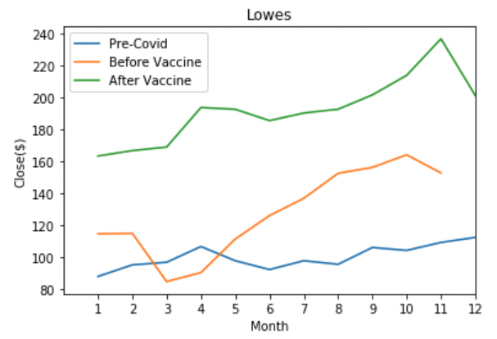
Lowes (LOW)
Summary of findings
Hypothesis: We assumed that the stock price for Lowes
will go down during the
pandemic before the vaccine release which disproven
Reference
Yahoo finance:
https://towardsdatascience.com/best-5-free-stock-market-apis-in-2019-ad91dddec984

Slide 10
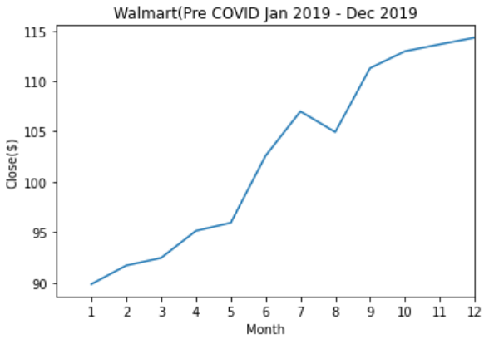
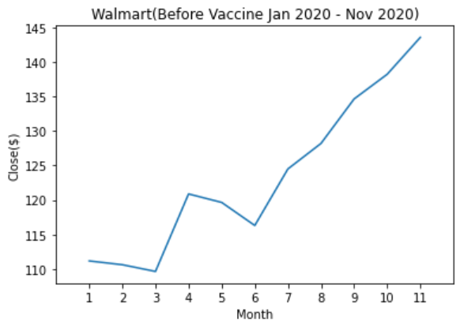
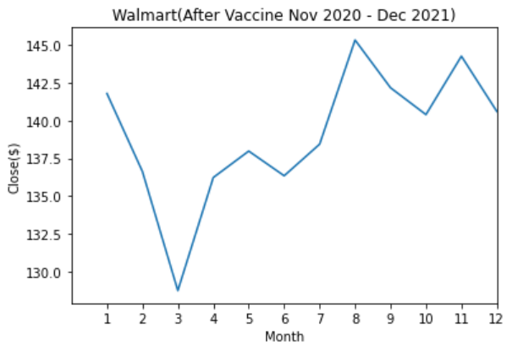
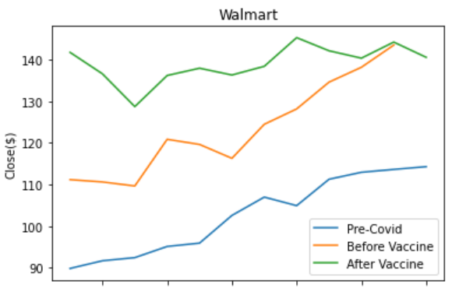
Walmart (WMT)
Summary of findings
Hypothesis: We assumed that the stock price for Walmart will go down during the pandemic before the vaccine release which was disproven
Primary drivers of increase stock was online shopping, drive up, and many stores remained
open
Reference
Yahoo is part of the Yahoo family of brands. (n.d.). https://search.yahoo.com/search?p=WMT
Fitzgerald, M. (2020, March 19). Walmart makes run to all-time highs amid coronavirus market plunge. CNBC. https://www.cnbc.com/2020/03/19/walmart-makes-run-to-all-time-highs-amid-coronavirus-market-plunge.html

Slide 11
Conclusion
Looking at the stock trend, all of the 4 retails companies were doing pretty well during covid both before and after the vaccine release. However, Lowes experience some drop in their stock in March and April 2020 before the vaccine release but then stock went back up in May
All companies were performing at a steady rate pre-covid
The data used for the analysis evidently proved that all the retail companies that we looked at did extremely well after the vaccine release between Nov-2020 to Dec-2021.

Slide 12
Questions?

